Slide 1
Problem identification (1-2 slides) Recommendation and key findings (1 slide) Modeling results and analysis (3-4 slides) Summary and conclusion (1 slide)

Slide 2
Problem identification
How can Big Mountain Resort create a better value ticket price above the average price of other resorts before the start of skiing season to address the operating cost of a chair lift of $1.54 M?

Slide 3
Recommendation and key findings
Big Mountain Resort modelled price is $95.87, actual price is $81.00.
Even with the expected mean absolute error of $10.39, this suggests there is room for an increase.
Based on the 350,000 expected visitors buying 5 day tickets, the recommended scenario to choose is to increase the vertical drop and add a ski lift as it supports increasing the ticket price. If Big Mountain Resort wants to close runs, the model suggests that closing 3-5 runs have the same plateaued revenue change and that closing 6-8 runs have the same plateaued revenue change.

Slide 4
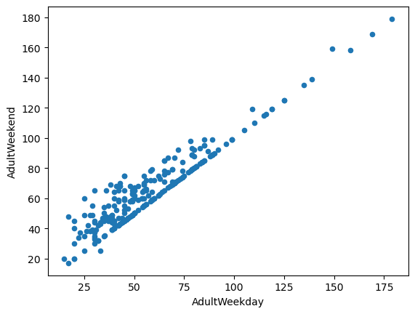
Modeling results and analysis: Target Feature
‘AdultWeekend’ and ‘AdultWeekday’ were highly correlated and ‘AdultWeekend’ had fewer missing values.
The target feature is ‘AdultWeekend’, which best predicts ticket price.

Slide 5
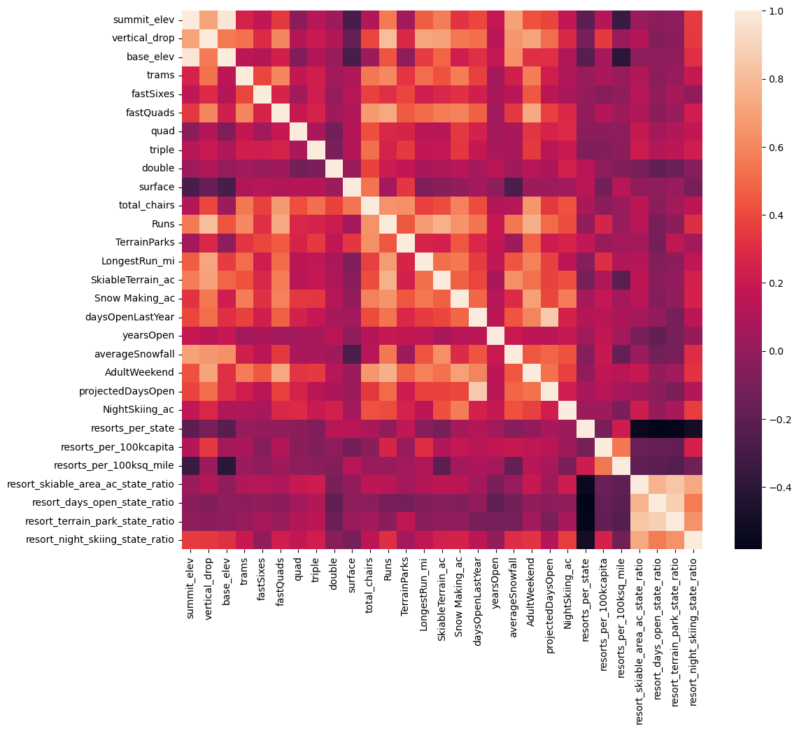
Modeling results and analysis: Feature Heat Map
We engineered some features as ratios of resort features to total state features and examined a feature correlation heatmap along with scatter plots against the ticket price
Some areas of interested include 'fastQuads', 'vertical_drop', 'total_chairs', 'Runs', and 'Snow Making_ac'.

Slide 6
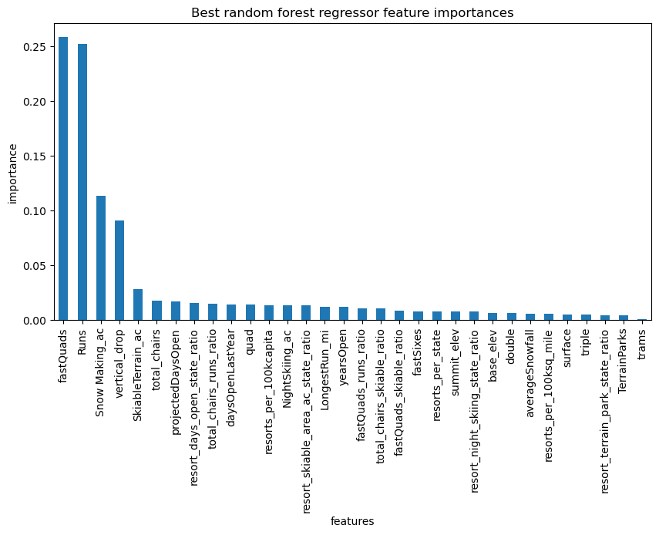
Modeling results and analysis: Random Forest Model Vs Linear Regression Model
The dominant top four features are in common between the linear and random forest model (‘fastQuads’, ‘Runs’, ‘Snow Making_ac’, ‘vertical_drop’).
The random forest model has a lower cross-validation mean absolute error by almost $1. It also exhibits less variability. Verifying performance on the test set produces performance consistent with the cross-validation results.

Slide 7
Modeling results and analysis: Scenario 2
In this scenario, Big Mountain is adding a run, increasing the vertical drop by 150 feet, and installing an additional chair lift.
This scenario increases support for ticket price by $1.99
Over the season, this could be expected to amount to $3474638

Slide 8
Summary and conclusion
Big Mountain Resort's current ticket price is 81. We must have more data to help us determine whether competitors are overpricing or underpricing and more data on operating costs. The recommended scenario to choose is to increase the vertical drop and add a ski lift as it supports increasing the ticket price.
Even though Big Mountain had high scores on the features used in the model (e.g. snow making area, number of chairs, vertical drop, etc.), the resort is the highest ticket price in Montana, which could explain why the modeled price might be higher than the current price as resorts in other states may simply charge more. We can do more EDA to see if this is true, but it shouldn't come as a surprise to business leaders if Big Mountain is the most expensive in Montana as the chart shows. Using this model, we can avoid shutting down runs to justify increasing the ticket price, but we do not have access to the operating costs of the runs. The model was ultimately helpful in showing that Scenario 2 would be a good way to justify increasing the ticket price.

